Slide 1
Agrégation spatiotemporelle pour la visualisation de traces d’exécution
Damien Dosimont
Advisor: Guillaume Huard – Co-advisor: Jean-Marc Vincent

Slide 2


Systems and applications become more and more complex to analyze

Slide 3



Embedded systems
f(x)/s
Not developer
friendly
Quantity of
events over time
Real time
Deep software
stack

Slide 4



Parallel systems
f(x)/s
Resource
sharing
Complex
& Distributed
Artchitecture
Quantity of
events over time
Indeterminism
Middlewares

Slide 5





Trace Analysis
Instrument complex system/application
Collect information about the execution and save them in a file
Process trace data
Statistics
A
Automatic approach
Analyze the content
Visualization

Slide 6

Main thread

Slide 7




TS Record use case
Streaming
Record
TV program
Set-top box
Hard drive

Slide 8

May the quality of service be with you

Slide 9
How to analyze this application?
?

Slide 10
How we imagine analyzing the application
Space-time diagram inspired by Gantt Chart

Slide 11
How we imagine analyzing the application
Function green(){
…
}
Function red(){
…
}
Function purple(){
…
}

Slide 12
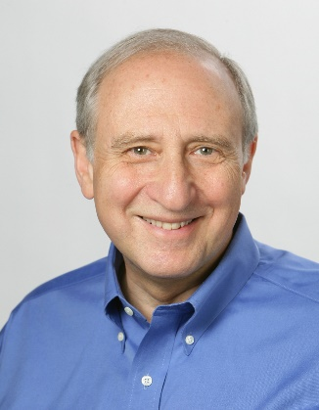




Shneiderman’s mantra
Overview first,
Zoom
and
Filter,
then
Details-on-demand
}

Slide 13
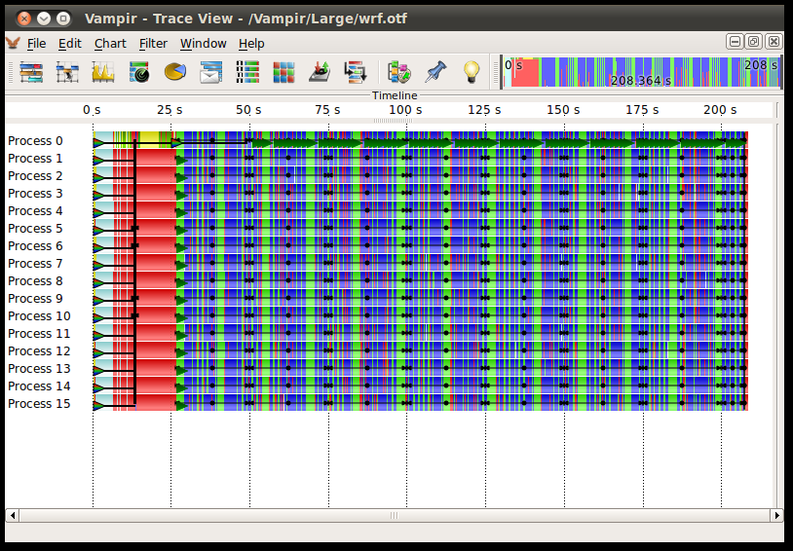
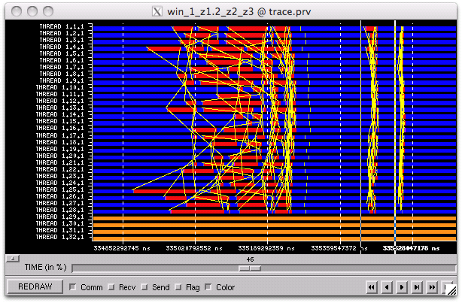
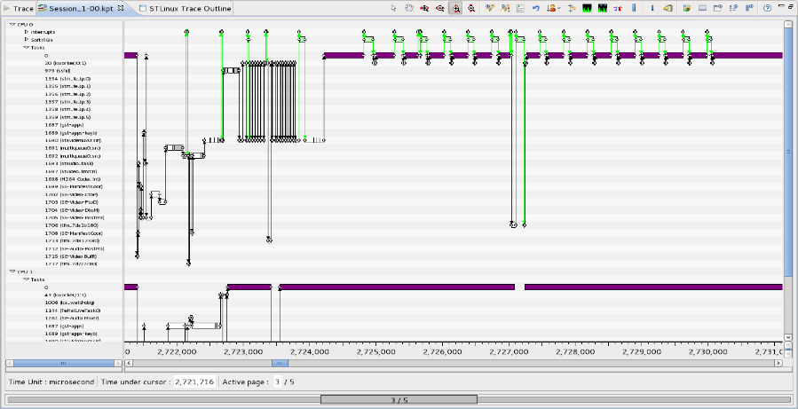
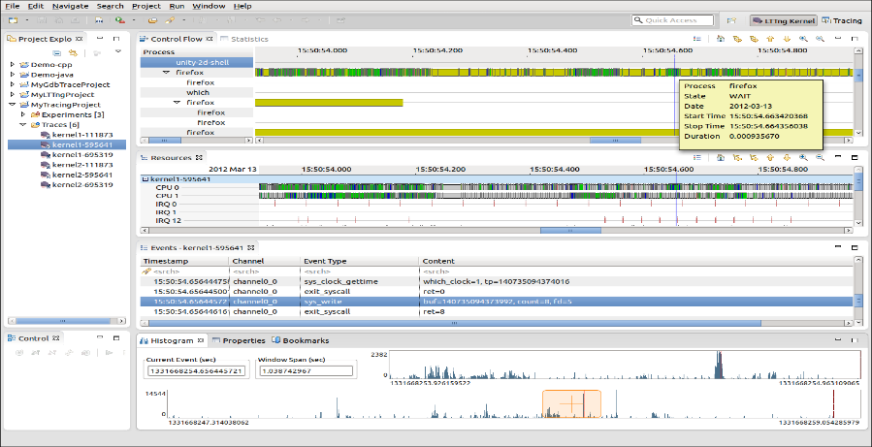
Examples of tools using Gantt chart
Vampir
Paraver
T-Charts (Lite)
Trace Compass

Slide 14





What about scalability?

Slide 15
A few figures…
TS Record use case
82 second duration
258,519 events
12.7 MB
482 second duration
1,642,033 events
83.3 MB
LU class C 700 MPI threads running on G5K (Nancy)
71 second duration
218,457,456 events
12.3 GB

Slide 16

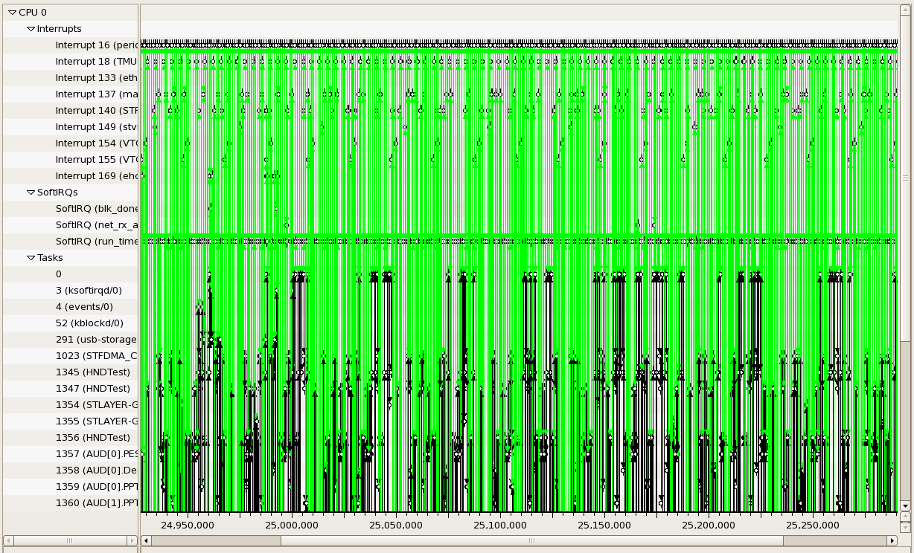
Visualization support

Slide 17
Visualization support
+
=
≈
6 graphical objects
4 available pixels
Fitting graphical
objects with pixels
Final representation:
-some objects are lost
-proportions are not kept

Slide 18
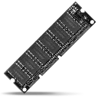


Performance
Memory Limitations
Hardware performance
Algorithmic complexity
Libraries, components, languages, etc.

Slide 19

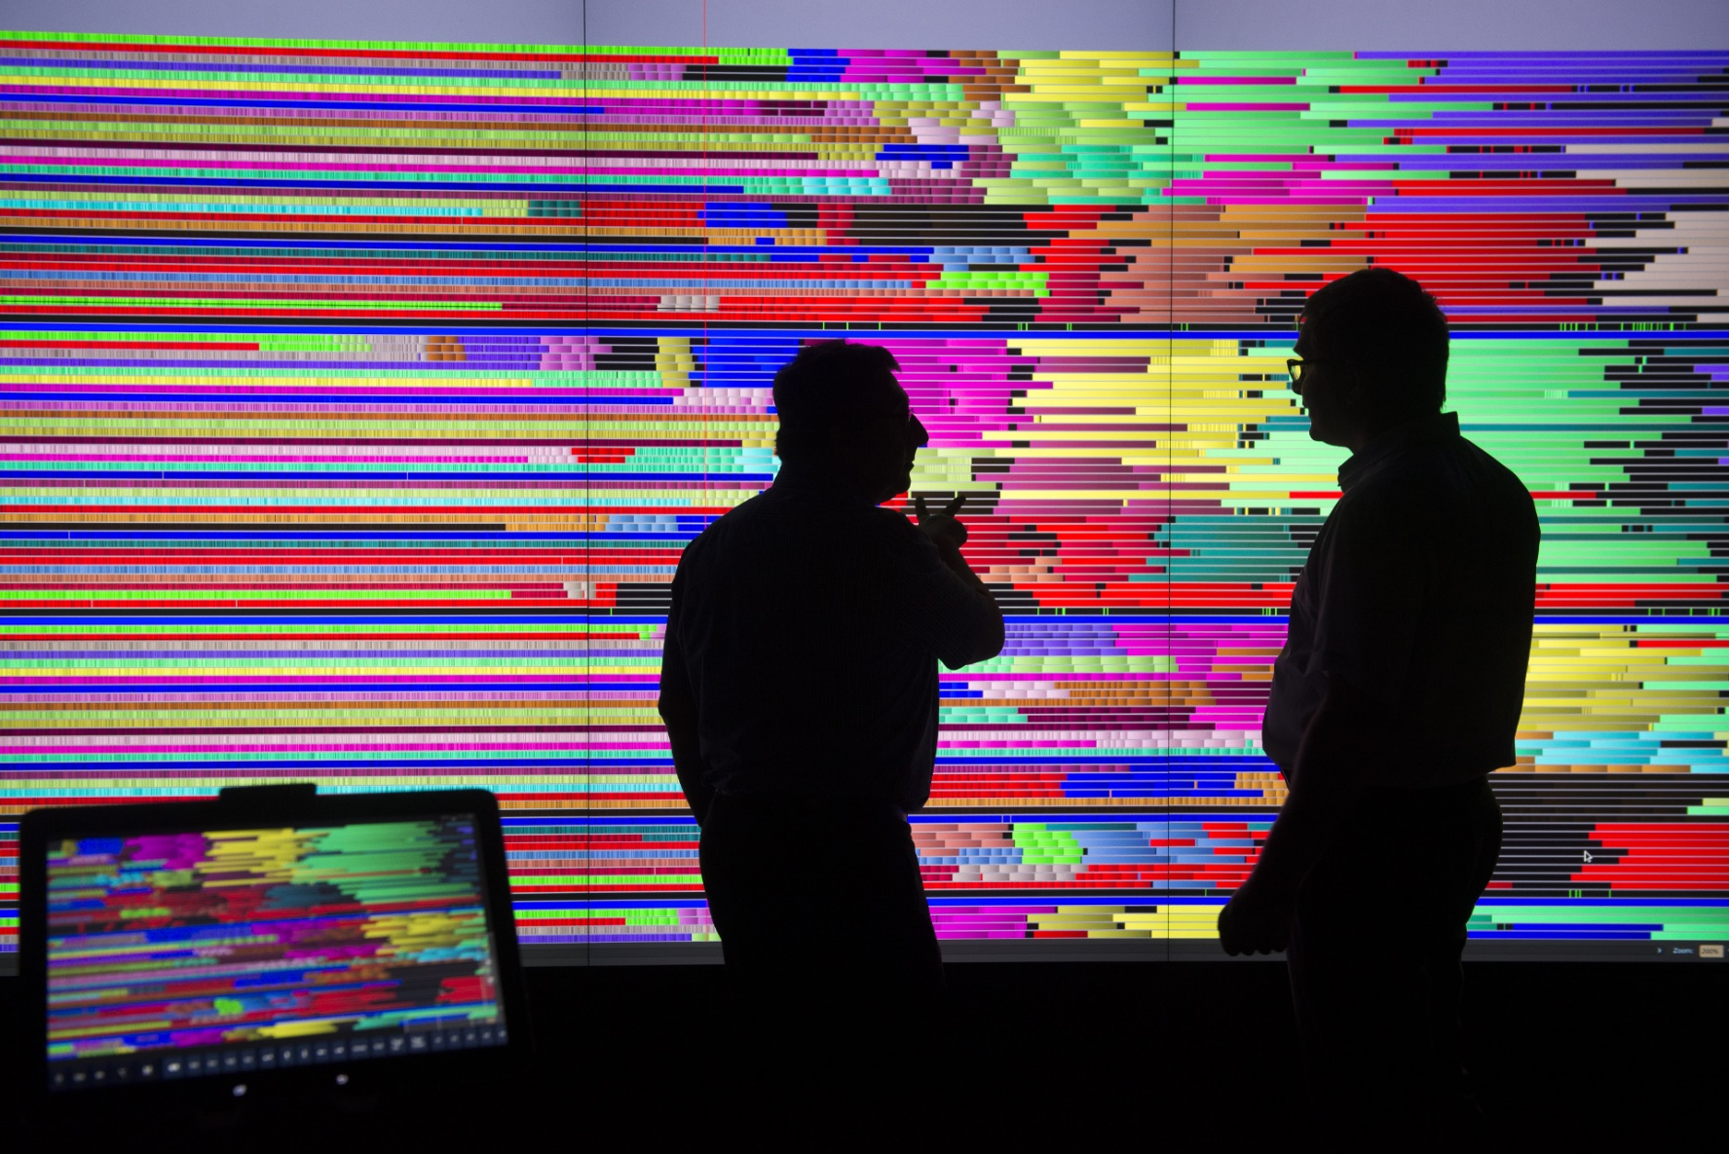
User

Slide 20


Shneiderman’s mantra
Overview first,
Zoom
and
Filter,
then
Details-on-demand
}

Slide 21

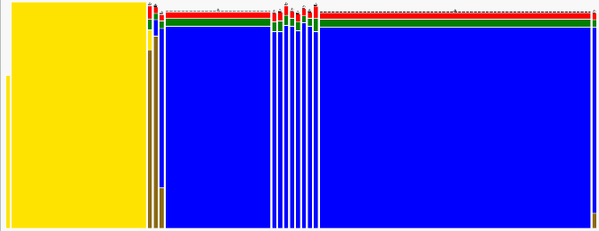
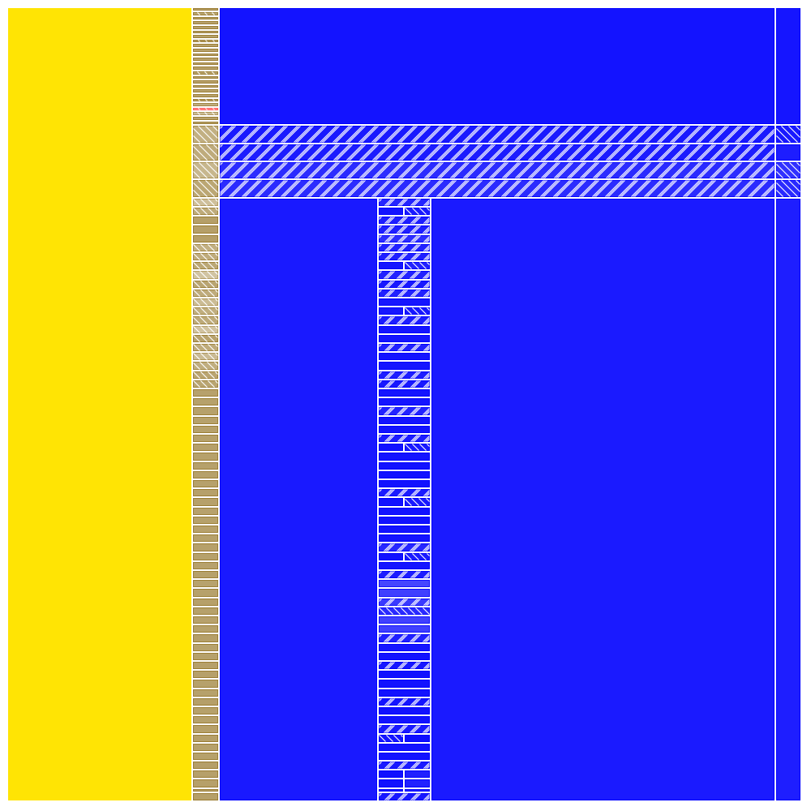

Objectives

Slide 22





Outline
Context
Temporal Aggregation
Spatiotemporal Aggregation
Implementation: Ocelotl Analysis Tool
Conclusion

Slide 23

Temporal Analysis

Slide 24
Interest of Temporal Analysis

Slide 25




Lamarche-Perrin’s method
Microscopic
Representation
Abstraction
Complex
System
Microscopic
Obervation
Macroscopic
Representation
Method based on Partition+Aggregation
Analyst

Slide 26
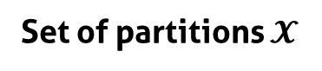

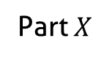
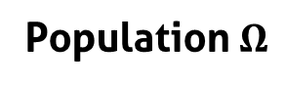
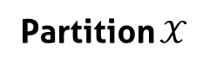
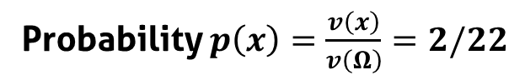
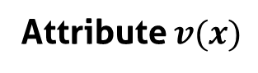
Notations
Part $X$
5
Population $Ω$
1
5
9
1
Individuals $x$
9
1
1
4
2
Attribute $v(x)$
2
4
Probability $p\left(x\right)=\frac{v\left(x\right)}{v\left(Ω\right)}=2/22$
Partition $𝒳$
Set of partitions $𝓧$
5
5
1
5
5
5
1
1
9
1
1
9
9
1
9
9
1
1
1
1
2
2
2
2
4
…
4
4
4
4
2

Slide 27
From the partition to the interpretation
5
5
1
15
5
9
5
1
1
1
2
6
3
4
3
Partition
Aggregation
(sum)
Redistribution
(uniform)
Visualization

Slide 28
How to choose the « good » partitions?
?
Best Partition Problem

Slide 29
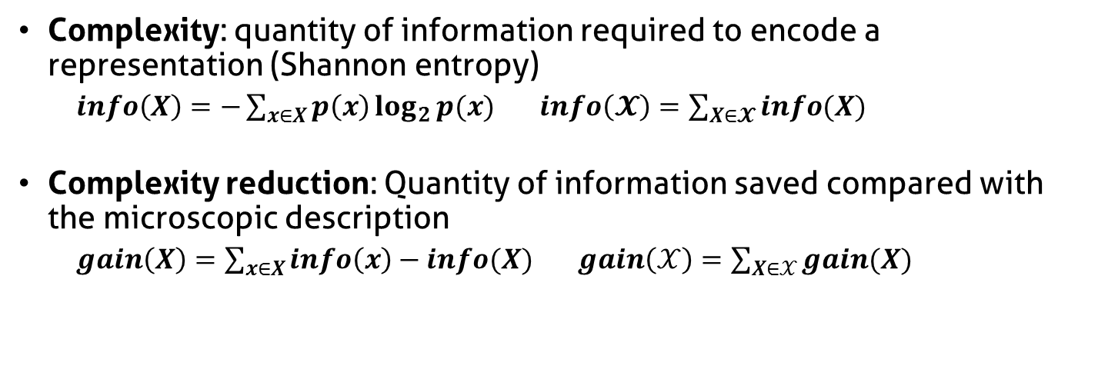
Complexity reduction
Complexity: quantity of information required to encode a representation (Shannon entropy)
$info\left(X\right)=−\sum_{x∈X}{p\left(x\right)\log_{2}{p(x)}}$ $info\left(𝓧\right)=\sum_{X∈𝓧}{info(X)}$
Complexity reduction: Quantity of information saved compared with the microscopic description
$gain\left(X\right)=\sum_{x∈X}{info\left(x\right)−info(X)}$ $gain\left(𝒳\right)=\sum_{X∈𝒳}{gain(X)}$
Complexity reduction
5
5
5
1
1
1
1
1
1
9
9
9
2
2
2
4
4
4
Number of elements (aggregates)

Slide 30
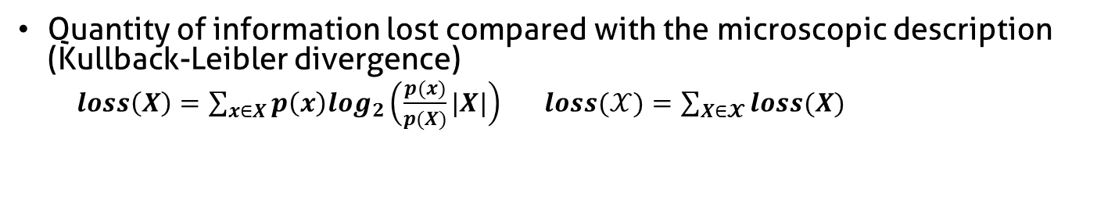
Information Loss
Quantity of information lost compared with the microscopic description (Kullback-Leibler divergence)
$loss\left(X\right)=\sum_{x∈X}{p\left(x\right)log_{2}\left(\frac{p(x)}{p(X)}|X|\right)}$ $loss(𝒳)=\sum_{X∈𝓧}{loss(X)}$
5
High
Information Loss
4
1
1
4
4
9
4
4
4
4
4
5
Low
Information Loss
4
4
4
4
4
4
4
4
4
3
4

Slide 31
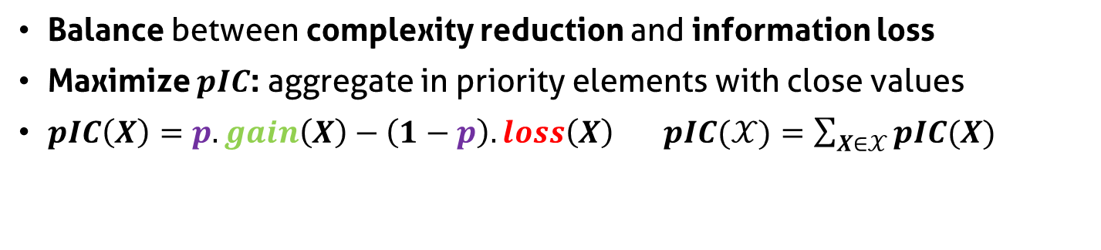
Parametrized Information Criterion
Balance between complexity reduction and information loss
Maximize $pIC$: aggregate in priority elements with close values
$pIC\left(X\right)=p.gain\left(X\right)−\left(1−p\right).loss\left(X\right)$ $pIC(𝒳)=\sum_{X∈𝒳}{pIC(X)}$
Parameter p
Complexity reduction
5
5
5
1
1
1
1
1
1
9
9
9
2
2
2
4
4
4
Information loss

Slide 32


Constrain the partition
Reduce set of partition size
Decrease algorithmic complexity
Bring coherence with syntaxic and semantic characteristics of the system

Slide 33
How to adapt LP method to trace analysis ?
?
?
?
Microscopic
Representation
?
Abstraction
Complex
System
Microscopic
Observation
?
Macroscopic
Representation
Analyst

Slide 34

How to adapt LP method to trace analysis
Microscopic
Representation
Abstraction
Trace
Microscopic
Observation
Macroscopic
Representation
Analyst

Slide 35

Original microscopic model
Function $M^{t}$ from $T$to $ℝ$+
t1
t2
t3
t4
t5
Time (discrete)

Slide 36
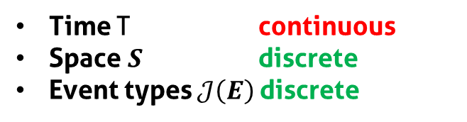
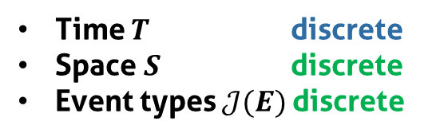
Build a microscopic model from the trace
Trace =
Nanoscopic
Model
Discretization
Microscopic
Model
Time T continuous
Space $S$ discrete
Event types $𝒥\left(E\right)$discrete
Time $T$ discrete
Space $S$ discrete
Event types $𝒥(E)$discrete

Slide 37

Microscopic model structure
Function $M^{t}$ from $S×T×𝒥(E)$to $ℝ$+
J5
J4
J3
Event types
J2
J1
s1
Space
s2
s3
t1
t2
t3
t4
t5
Time (discrete)

Slide 38
Fill the microscopic model
Time (continuous)
Sum of state durations
s1
s2
Time slice
Space
s3
J5
J4
Event types
J3
J2
d1 + d2 + p1*d3
J1
s1
d1+d2+p1*d3
s2
Space
s3
t1
t2
t3
t4
t5
Time (discrete)

Slide 39
Aggregate the microscopic model
Original algorithm:
scalar values
t1
t2
t3
t4
t5
Time (discrete)
Objective:
multidimensional
values
t1
t2
t3
t4
t5
Time (discrete)

Slide 40



Partition/Aggregation pipeline
Microscopic
Representation
Abstraction
Trace
Microscopic
Obervation
Macroscopic
Representation
Quality
Measures
Best Cut
Computation
Partition
Computation
Visualization
Technique
Analyst

Slide 41
Visualization
Microscopic
Representation
Abstraction
Trace
Microscopic
Obervation
Macroscopic
Representation
Quality
Measures
Best Cut
Computation
Partition
Computation
Visualization
Technique
Analyst

Slide 42
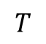
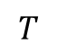
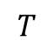
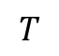
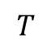
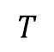
Visualize the trace abstraction
Bar chart
$$T$$
Colored
partition
$$T$$
$$T$$
Stacked bar
chart
$$T$$
$$T$$
Mode
$$T$$
Spatial aggregation
Aggregation of event types

Slide 43
Stacked bar chart visual aggregation
minimal height
blue + orange event type
total height < minimal height
blue event type
height < minimal height
blue + orange event type
individual height < minimal height
total height > minimal height
Decrease available height

Slide 44
Example of analyses

Slide 45
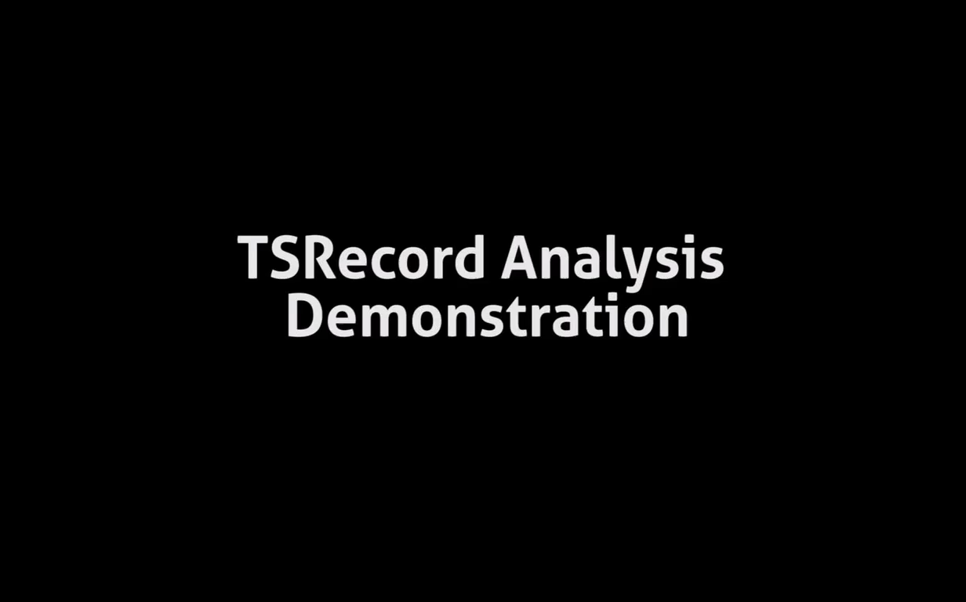
TS Record analysis

Slide 46

LU class C (700 processes) on G5K
MPI_Allreduce
MPI_Wait
MPI_Send
700
Activity Ratio
0
0 s
74 s
Time
MPI_Recv
MPI_init

Slide 47

We need some space!

Slide 48

Spatiotemporal Analysis
+

Slide 49




Hardware/software hierarchy
Hardware components
Site
Clusters
Nodes
Cores
Threads
Software components

Slide 50
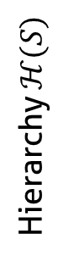

Hierarchize the spatial dimension
Function $M^{st}$ from $S×T×𝒥(E)$to $ℝ$+
Event types
J3
J2
J1
s1
Sa
s2
Hierarchy $ℋ(S)$
s3
S
s4
Sb
s5
t1
t2
t3
t4
t5
Time (discrete)

Slide 51
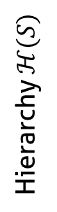
Aggregate the microscopic model
s1
Sa
s2
Hierarchy $ℋ(S)$
s3
S
s4
Sb
s5
t1
t2
t3
t4
t5
Time (discrete)

Slide 52
Forbidden Aggregates
s1
Sa
s2
Hierarchy $ℋ(S)$
s3
S
s4
Sb
s5
t1
t2
t3
t4
t5
Time (discrete)

Slide 53
Best Cut Algorithm: naive approach
Spatial or
Temporal
Cut
Recursion
Spatial or
Temporal
Cut
Recursion
Spatial or
Temporal
Cut

Slide 54

Best Cut Algorithm: dynamic programming
Save the intermediate results
Avoid redundant evaluation
Spatial or
Temporal
Cut
Unavoidable redundancy
Recursion
Spatial or
Temporal
Cut
Recursion
Spatial or
Temporal
Cut

Slide 55
Visualize the abstraction

Slide 56
Visual aggregation
Decrease available height

Slide 57
Example of analyses

Slide 58
LU class C (700 processes) on G5K
MPI_Allreduce
MPI_Wait
MPI_Send
700
Activity Ratio
0
0 s
74 s
Time
MPI_Recv
MPI_init

Slide 59
LU class C (700 processes) on G5K
graphene
graphite
Nancy
griffon
MPI_Allreduce
MPI_Recv
MPI_init
0 s
Time
74 s

Slide 60

Implementation: Ocelotl Analysis Tool

Slide 61
Presentation

Slide 62


Ocelotl Architecture

Slide 63
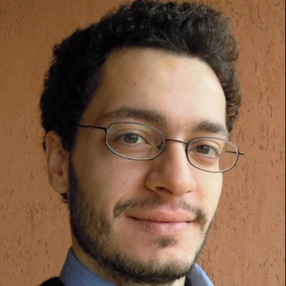

Framesoc

Slide 64
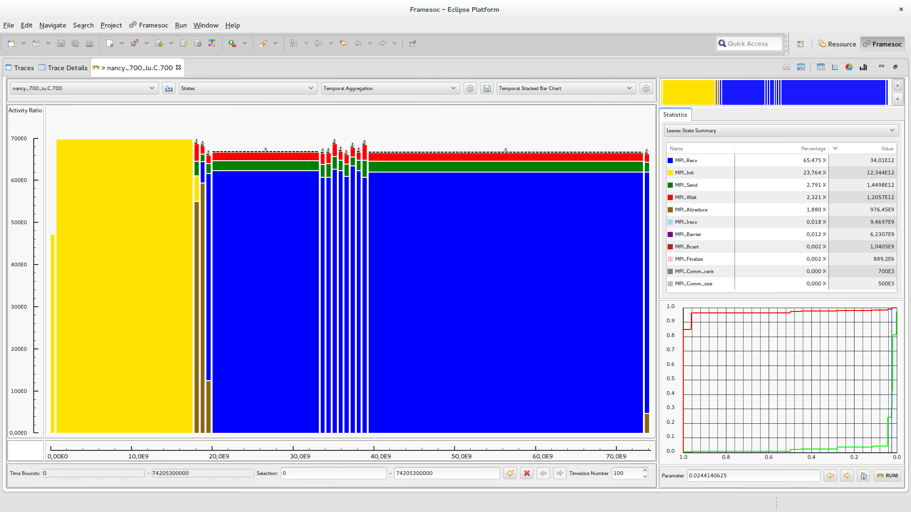
Shneiderman’s mantra: Overview

Slide 65
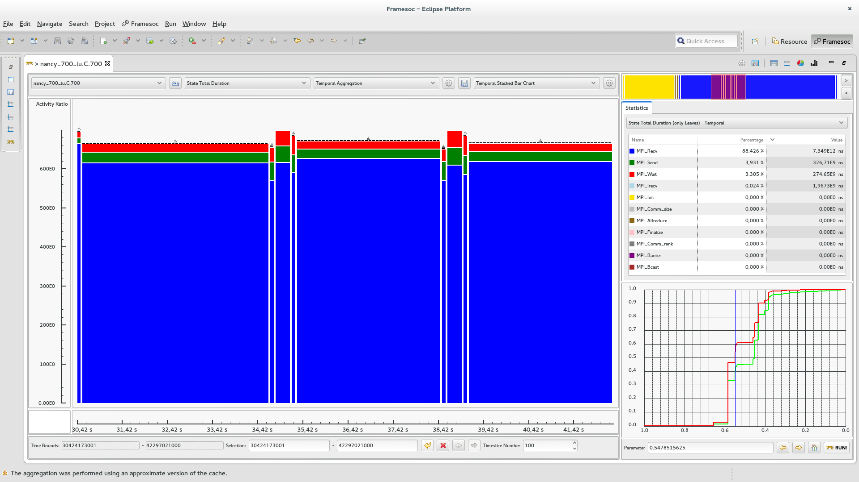
Shneiderman’s mantra: Zoom

Slide 66
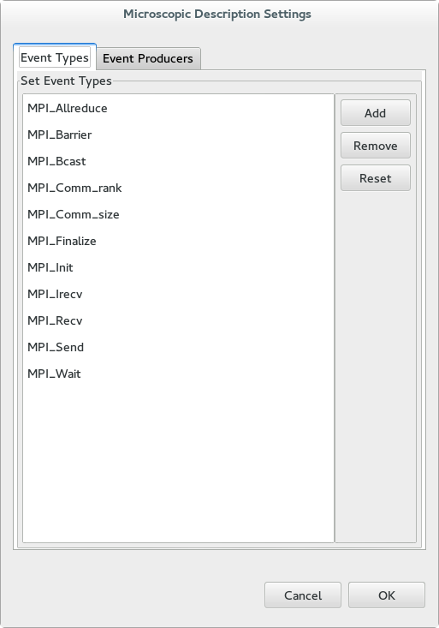
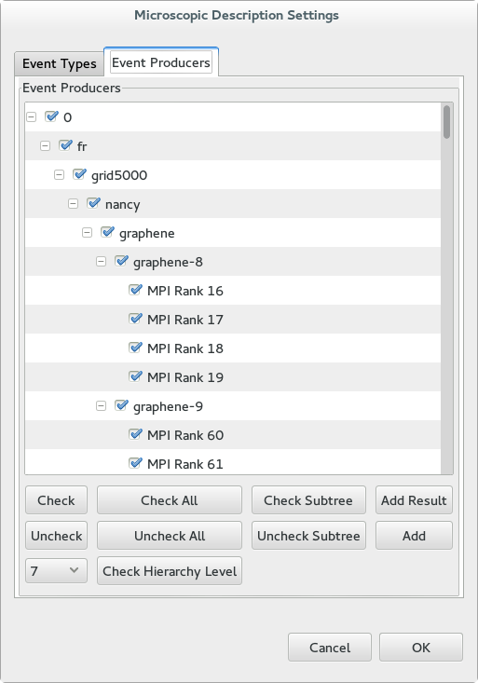
Shneiderman’s mantra: Filter
Event type filtering
Resource filtering

Slide 67
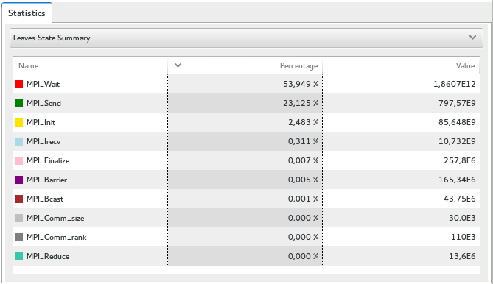
Shneiderman’s mantra: Details on demand

Slide 68
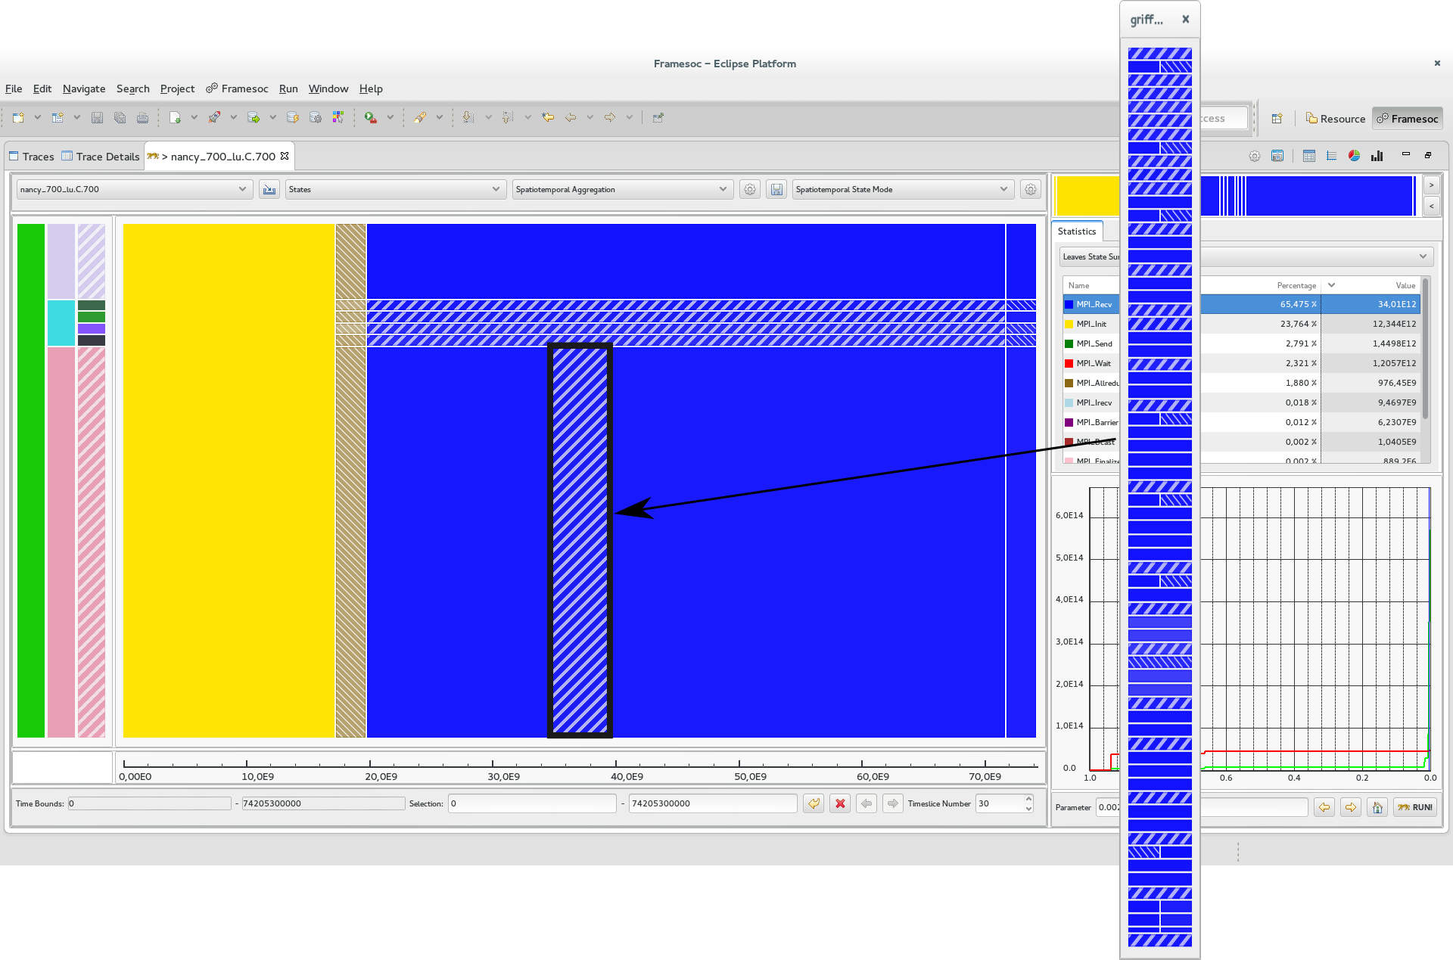
Shneiderman’s mantra: Details on demand

Slide 69
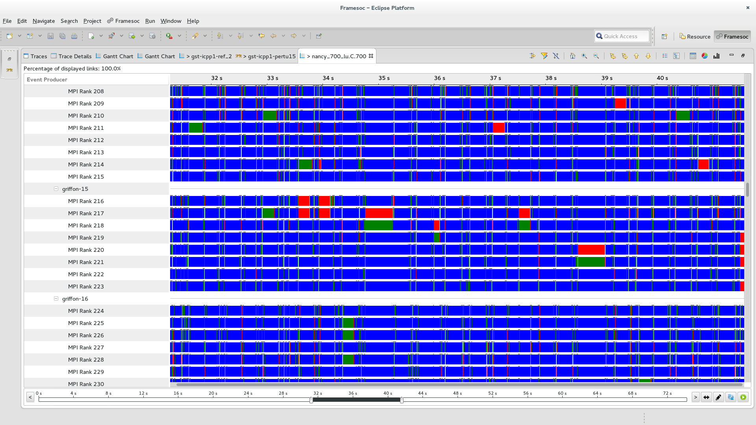
Shneiderman’s mantra: Details on demand

Slide 70


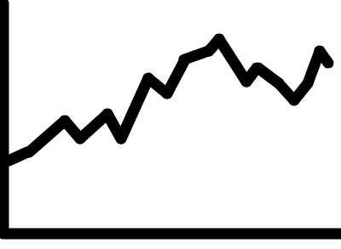
Performance
Microscopic Model
Cache
Query
Optimization
LPAggreg C++ library
Quality
Measures
Microscopic
Osbervation
Microscopic
Representation
Quality
Curves
Trace DB
Best Cut
Computation
Macroscopic
Representation
Visualization
Technique
Partition
Computation
Analyst

Slide 71
Microscopic Model Persistent Cache
First Time :
Trace DB
Microscopic
Osbervation
Fine Time Slice
Granularity
Microscopic Model
Persistent
Cache
Microscopic
Model
Time slice numbers
are multiple
Perfect
Microscopic Model
Other Times:
Approximate
Microscopic Model
Persistent
Cache
Time slice numbers
are not multiple

Slide 72
Microscopic Model Persistant Cache
Cache Size << Trace (Microscopic model spare matrices)
Reading time only depends on microscopic model size (and content) and not on original trace file size

Slide 73
In practice…
Real traces:
Up to 12 GB (218 million of events)
Temporal: ~1500 resources
Spatiotemporal: ~700 resources
Without cache: ~5 minute preprocess
With cache: ~20 second preprocess
Synthetic traces:
Up to 68 GB (2 billion of events)
Temporal: ~ 100 000 resources, 10 event types, 100 time slices
Spatiotemporal: ~10 000 resources, 10 event types, 30 time slices
Without cache: ~20 minute preprocess
With cache: a few minute preprocess

Slide 74
Conclusion

Slide 75
Trace Overviews
Data aggregation following Lamarche-Perrin’s method
Temporal aggregation: significant extension to trace analysis
Spatiotemporal aggregation: new algorithm
Visualization techniques
Punctual visual aggregation
Compliant with Shneiderman’s mantra first step

Slide 76
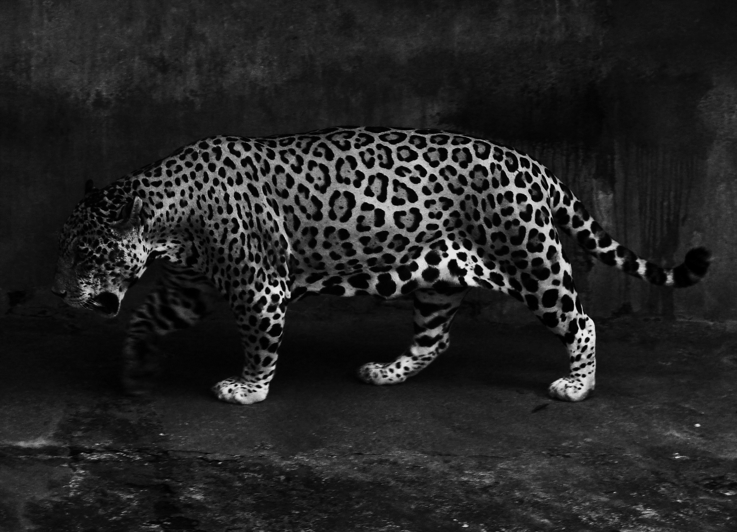
Ocelotl Analysis Tool
Implementation of the overviews/data aggregation
Interaction mechanisms satisfying Shneiderman’s mantra
Performance ensuring for large traces
Modularity

Slide 77
Publications
International Conferences
A Spatiotemporal Data Aggregation Technique for Performance Analysis of Large-scale Execution Traces. Damien Dosimont, Robin Lamarche-Perrin, Lucas Mello Schorr, Guillaume Huard, Jean-Marc Vincent, IEEE Cluster 2014, pages 149-157, Madrid, September 2014.
Efficient Analysis Methodology For Huge Application Traces. Damien Dosimont, Generoso Pagano, Guillaume Huard, Vania Marangozova-Martin, Jean-Marc Vincent, 2014 International Conference on High Performance Computing & Simulation, pages 951-958, Bologna, June 2014.
Trace Management and Analysis for Embedded Systems. Generoso Pagano, Damien Dosimont, Guillaume Huard, Vania Marangozova-Martin, Jean-Marc Vincent, 2013 IEEE 7th International Symposium on Embedded Multicore Socs (MCSoC), pages 119-122, Tokyo, September 2013.
Workshops
Ocelotl: Large Trace Overviews Based on Multidimensional Data Aggregation. Damien Dosimont, Youenn Corre, Lucas Mello Schnorr, Guillaume Huard, Jean-Marc Vincent, 8th International Parallel Tools Workshop (IPTW’14), Stuttgart, October 2014.
Agrégation temporelle pour l’analyse de traces volumineuses. Damien Dosimont, Guillaume Huard, Jean-Marc Vincent, 10ème Atelier en Evaluation de Performances, Sophia Antipolis, June 2014.
La visualisation de traces, support à l’analyse, déverminage et optimisation d’applications de calcul haute performance. Damien Dosimont, Guillaume Huard, Jean-Marc Vincent, Atelier Visualisation d’informations, interaction et fouille de données (VIF) de la 13e Conférence Francophone sur l’Extraction et la Gestion des Connaissances (EGC’2013), pages 55-66, Toulouse, January 2013.

Slide 78

Perspectives?

Slide 79
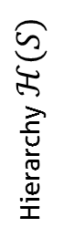
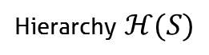
New aggregations
5
4
Discrete Dimension
Hierarchy $ℋ(S)$
3
S
2
1
1
2
3
4
5
Hierarchy $ℋ(S)$
Discrete Dimension
S

Slide 80
Improving the performance
Parallelization
Trace reading
Algorithm
Data structures (spare matrices)
Dynamic control
More caches
Prefetching, anticipation

Slide 81




New applications
Representation of preliminary abstracted traces
Trace comparison
Memory analysis
Other domains

Slide 82

Thank you for your attention!

Slide 83
Backup

Slide 84

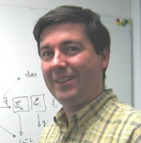


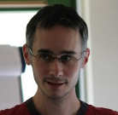

Thanks

Slide 85
Main thread: a recording application
Streaming
Record
TV program
Set-top box
Hard drive
TS Record use case

Slide 86
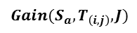
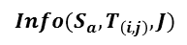
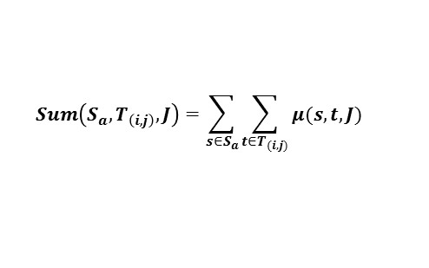
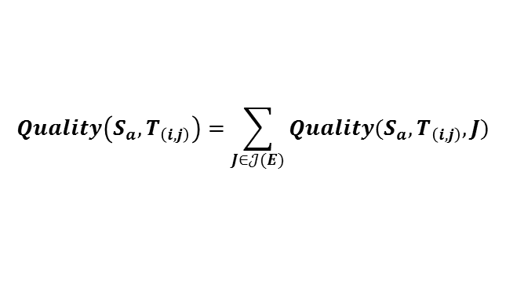
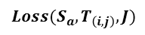
Quality computation
Intermediate measures
Quality measures
$$Sum\left(S_{a},T_{\left(i,j\right)},J\right)=\sum_{s∈S_{a}}{\sum_{{t∈T}_{(i,j)}}{μ(s,t,J)}}$$
$$Gain(S_{a},T_{\left(i,j\right)},J)$$
$$Info({S_{a},T}_{\left(i,j\right)},J)$$
$$Loss(S_{a},T_{\left(i,j\right)},J)$$
$$Quality\left(S_{a},T_{\left(i,j\right)}\right)=\sum_{J∈𝒥(E)}{Quality(S_{a},T_{\left(i,j\right)},J)}$$
s1
=
+
S
s2
=
+
=
+

Slide 87

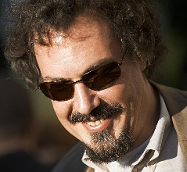
Elmqvist & Fekete’s criteria
Entity Budget
Visual Summary
Visual Simplicity
Discriminability
Fidelity
Interpretability

Slide 88


How to build a polynomial algorithm?
Dynamic programming (divide and conquer)
Covering relation (lattice)
Quality measure additivity

Slide 89
Visualize structure and temporal behavior
Space-time diagram inspired by Gantt Chart
Exemple of a sequential pattern with context switches
Exemple of a parallel execution with communications

Slide 90



Best Partition problem
Find the partitions that maximize (minimize) quality measures
Quality measures are monotone, decomposable, and may be additive
$$X_{A}$$
$$Quality(𝒳) = Quality(X_{A}) + Quality(X_{B}) + Quality(X_{C})$$
5
1
9
1
$$X_{B}$$
2
4
$$X_{C}$$

Slide 91

Fill the microscopic model
Event occurrences
Average state duration
Variable mean
Time slice
Time slice
Time slice
1 + 1 + 1
d1 + d2 + p1*d3
a
b
3
(d1+d2+p1*d3)/3
$$\frac{1}{b−a}\int_{a}^{b}{f\left(t\right)dt}$$

Slide 92

Lattice
Partial order

Slide 93

Complexity
Quantity of information required to encode a representation (theoretical)
Uncertainty about the elements of a description whose we only know the probability to appear of the different symbols that are associated with
$info\left(X\right)=−\sum_{x∈X}{p\left(x\right)\log_{2}{p(x)}}$ $info\left(𝓧\right)=\sum_{X∈𝓧}{info(X)}$
Complexity
5
5
5
1
1
1
1
1
1
9
9
9
2
2
2
4
4
4
Number of elements (aggregates)

Slide 94



In a few words…
Analysis of large execution traces, provided by
multimedia/embedded applications
parallel/scientific computing applications
Design of a method based on
visualization
data aggregation
interaction
following a top down approach
Design and implementation in an analysis software

Slide 95

Ex: Hierarchical aggregation
Spatial analysis
Admissible partitions

Slide 96

Ex: Ordered set aggregation
Temporal analysis
Admissible partitions

Slide 97







Information contained in traces
Spatial dimension ($S$)
Hardware resources
Software components
Temporal dimension (T)
Events ($E$)
Categories ($𝒞(E)$):
Types ($𝒥(E)$)

Slide 98




Quality computation of monodimensional values
Monodimensional microscopic model
Intermediate measures
$$Sum(T_{(i,j)})=\sum_{{t∈T}_{(i,j)}}{μ(t)}$$
Time (discrete)
Data structure of time intervals T(i,j)
$$Info(T_{\left(i,j\right)})$$
Quality measures
i
$$Gain(T_{\left(i,j\right)})$$
$$Loss(T_{\left(i,j\right)})$$
j

Slide 99





Quality computation of multidimensional values
Intermediate measures
$$Sum(s,T_{\left(i,j\right)},J)=\sum_{{t∈T}_{(i,j)}}{μ(s,t,J)}$$
Jr
Jb
s1
$$Info({s,T}_{\left(i,j\right)},J)$$
Quality measures
s2
$$Gain(s,T_{\left(i,j\right)},J)$$
$$Loss(s,T_{\left(i,j\right)},J)$$
=
+
+
+
$$Quality(T_{(i,j)})=\sum_{s∈S}{\sum_{J∈𝒥(E)}{Quality(s,T_{\left(i,j\right)},J)}}$$

Slide 100


Best cut computation
Compute, compare, and select pIC for time intervals
pIC=p*gain-(1-p)*loss
User provides p
Already
computed
Ex: 4 time slices
$$pIC=pIC(T_{3})+pIC(T_{4})$$
Possible cuts: Cut[i]
i=4
Cut[4]=4
$$pIC=pIC(T_{(3,4)})$$
i=3
or
Cut[3]=3 or 4
i=2
or
or
Cut[2]=2, 3 or 4
or
or
i=1
Cut[1]=1, 2, 3 or 4
or

Slide 101

Rebuild the best partition
Example
Cut[1]?
Cut[1]=2
Cut[2+1]?
Cut[3]=3
Cut[3+1]?
Cut[4]=4
Best Partition

Slide 102
Aggregate and redistribute the values
Microscopic model
Partition
?
Aggregation (sum)
!
Uniform redistribution

Slide 103

Build a microscopic model from the trace
Trace =
Nanoscopic
Model
Discretization
+ Hierarchization
Microscopic
Model
Time continuous
Space flat
Event types discrete
Time discrete
Space hierarchized
Event types discrete

Slide 104



Performance
! Query optimization
Microscopic
model
Qualities
Quality curves
Abstraction
Trace (DB)
Visualization
! Microscopic Model
Cache

Slide 105


Main thread
Parameter p increasing
$$T$$
$$T$$

Slide 106



CG class C (64 processes) on G5K
64
Rennes
Activity Ratio
0
64
Nancy
Activity Ratio
0
64
Grenoble
Activity Ratio
0
0 s
26 s
54 s
125 s
Time

Slide 107


Knowledge on the application
IP buffers
Memory
Hard drive
IP packets
sys_write()
flush-8:0
every
100 ms
Disk cache
every
5000 ms
230 KB

Slide 108
Multi agent system analysis
Analytic approach
Complex
System
Microscopic
Obervation
Microscopic
Representation
Analyst
Complexity
Quantity of data

Slide 109
Multi agent system analysis
Systemic approach
Microscopic
Representation
Abstraction
Complex
System
Microscopic
Obervation
Macroscopic
Representation
Analyst

Slide 110
Microscopic model structure
Function $M^{st}$ from $S×T×𝒥(E)$to $ℝ$+
Event types
J3
J2
J1
s1
s2
Space
s3
s4
s5
t1
t2
t3
t4
t5
Time (discrete)

Slide 111
How we imagine analyzing the application

Slide 112
Best Cut Algorithm : naive approach
Decomposition
Recursion
Decomposition
Recursion
Decomposition

Slide 113
Best Cut Algorithm : dynamic programming
Decomposition
Recursion
Save the intermediate results
Decomposition
Recursion
Decomposition
Avoid redundant evaluation

Slide 114
Solving the problem
IP buffers
Memory
Hard drive
IP packets
sys_write()
flush-8:0
every
100 ms
Disk cache
every
5000 ms
230 KB
quantity of data
During the flush, the cache is locked
Writing on the USB disk is slow, IP buffers are overflowed
Linux configuration: flush should depend on quantity of data and not on time

Slide 115

Context

Slide 116
Trace content
Microscopic
Representation
Abstraction
Trace
Microscopic
Observation
Macroscopic
Representation
Analyst

Slide 117
Trace content
Spatial dimension ($S$)
Hardware resources
Software components
Temporal dimension (T)
Events ($E$)
Categories ($𝒞(E)$):
Types ($𝒥(E)$)

Slide 118
Lamarche-Perrin’s Method

Slide 119
Query Optimization
Not optimized query: time interval + space elements + event types
Full overview: evaluate time, space and types is useless
Zoom or filter over less than 3 dimensions: queries can also be simplified
Advanced simplifications
Constant factor gain improves interactivity

Slide 120



Temporal Aggregation
$$𝒪({\left|T\right|}^{2}×\left|S\right|×\left|𝒥\left(E\right)\right|)$$
$$𝒪(\log_{2}\left(seuil\right)×{\left|𝓘\left(T\right)\right|×\left|T\right|}^{2})$$
$$𝒪({\left|T\right|}^{2})$$
Fixed values: $\left|S\right|=1000, \left|𝒥\left(E\right)\right|=10, threshold=0.001$

Slide 121



Spatiotemporal Aggregation
$$𝒪({\left|T\right|}^{2}×\left|ℋ(S)\right|×\left|𝒥\left(E\right)\right|)$$
$𝒪(\log_{2}\left(seuil\right)×{\left|𝓐\left(S×T\right)\right|×\left|T\right|}^{3}×|ℋ(S)|$)
$$𝒪({\left|T\right|}^{3}×|ℋ(S)|)$$
Fixed values: $\left|𝒥\left(E\right)\right|=10, threshold=0.001$

Slide 122

LU class C (700 processes) on G5K
Nancy
(no cluster/machine
level)
MPI_Allreduce
MPI_Recv
MPI_init
0 s
Time
74 s

Slide 123

Shneiderman’s mantra: Zoom

Slide 124

Shneiderman’s mantra: Zoom

Slide 125

Shneiderman’s mantra: Zoom

Slide 126

Shneiderman’s mantra: Zoom

Slide 127

Shneiderman’s mantra: Zoom

Slide 128








Embedded systems
Not developer
friendly
Real time
f(x)/s
Quantity of
events over time
Deep software
stack
Step-by-step debugger (ex: GDB)

Slide 129














Parallel systems
Indeterminism
Middlewares
f(x)/s
Complex
& Distributed
Artchitecture
Quantity of
events over time
Resource
sharing
Step-by-step debugger (ex: GDB)

